Slide 1

NO name
Adidas tech sportS: “SAYCHEESE”

Slide 2
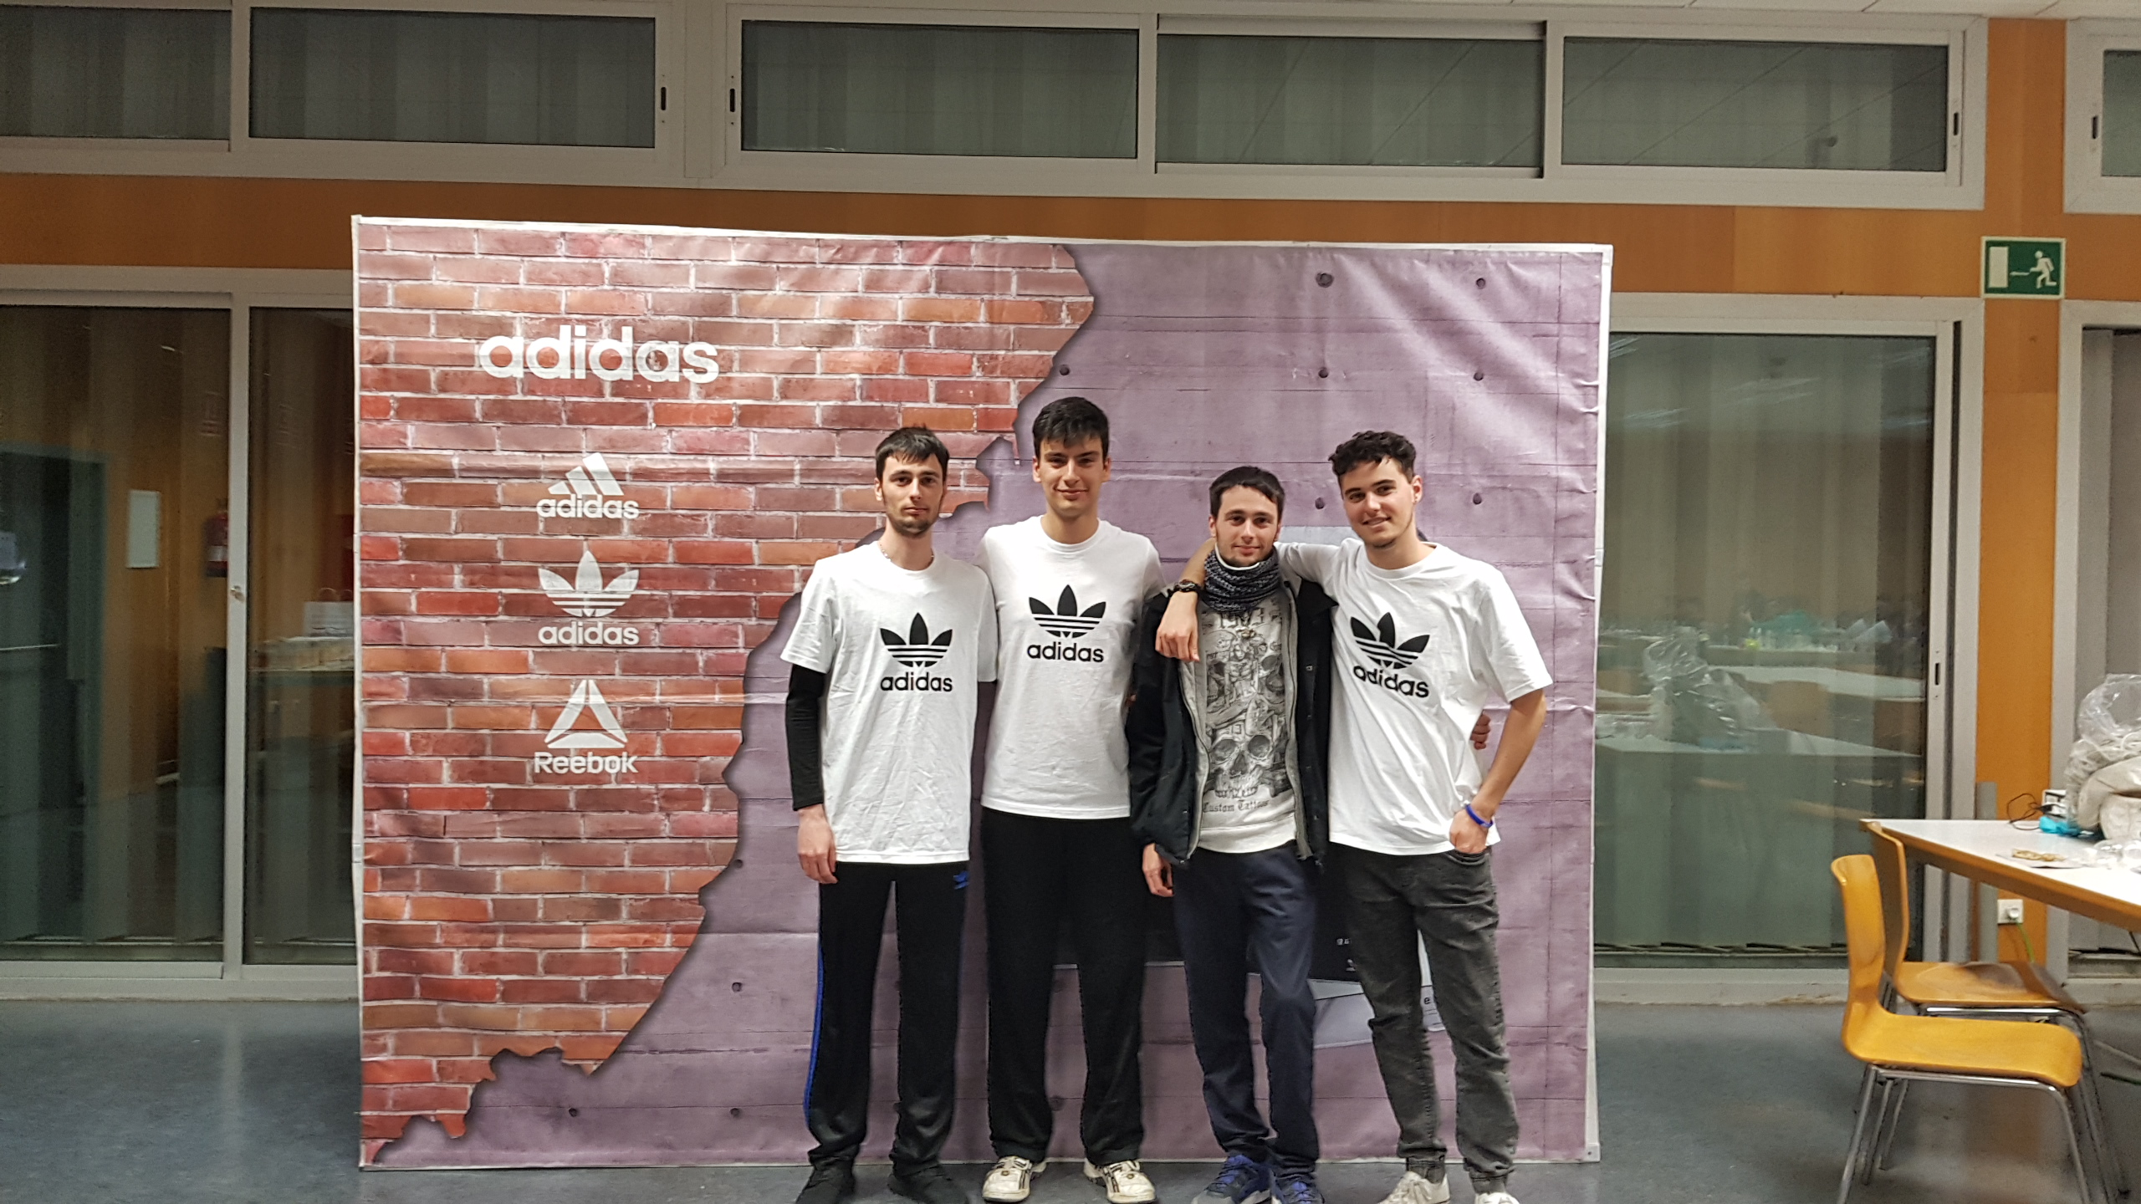
MIEMBROS DEL EQUIPO

Slide 3

AGENDA
Evolución del deporte
ENFOQUE
VALOR
DEMO
Vectores de mejora
Q&A

Slide 4
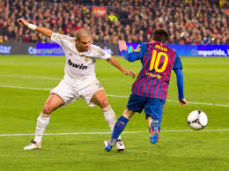
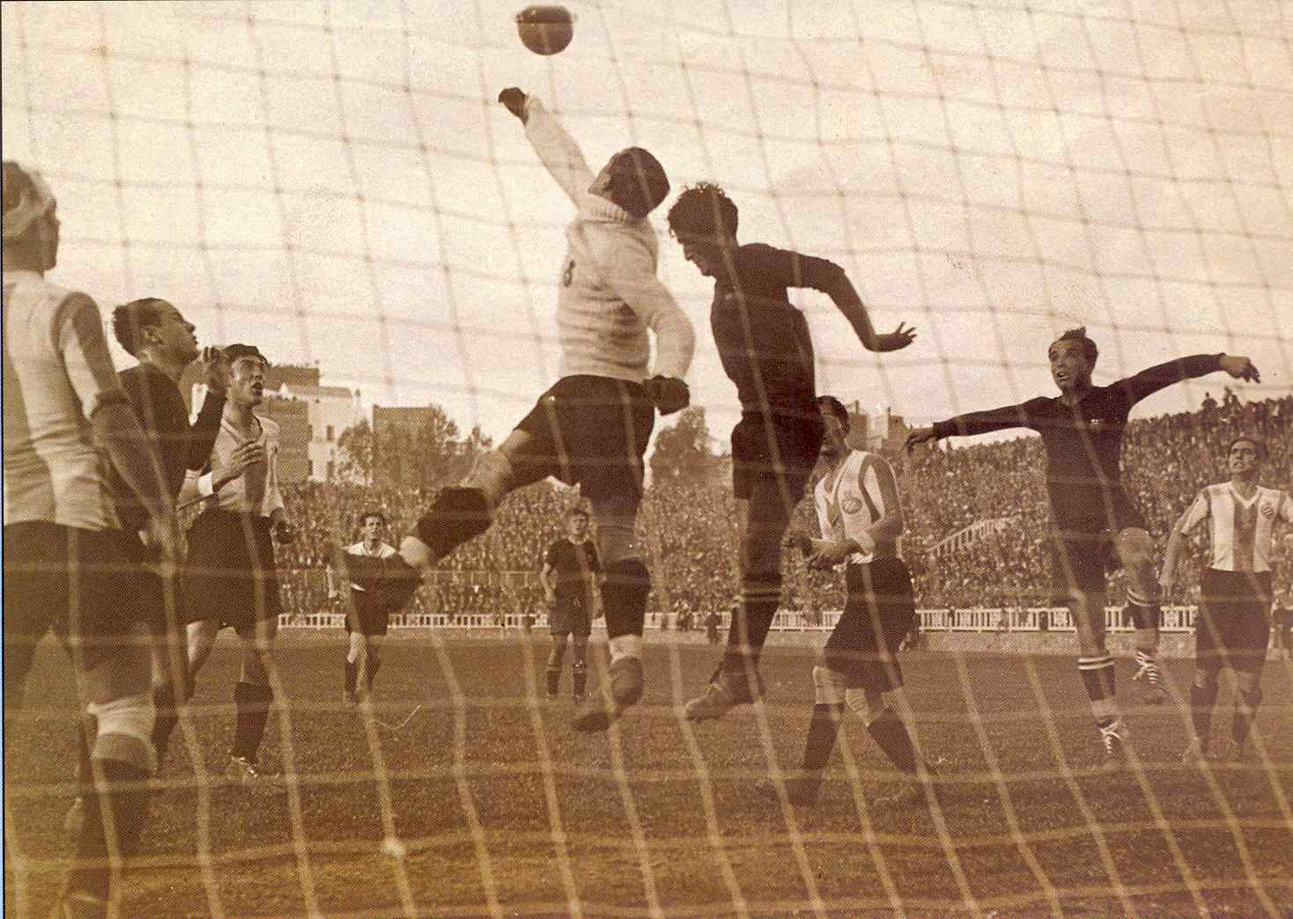
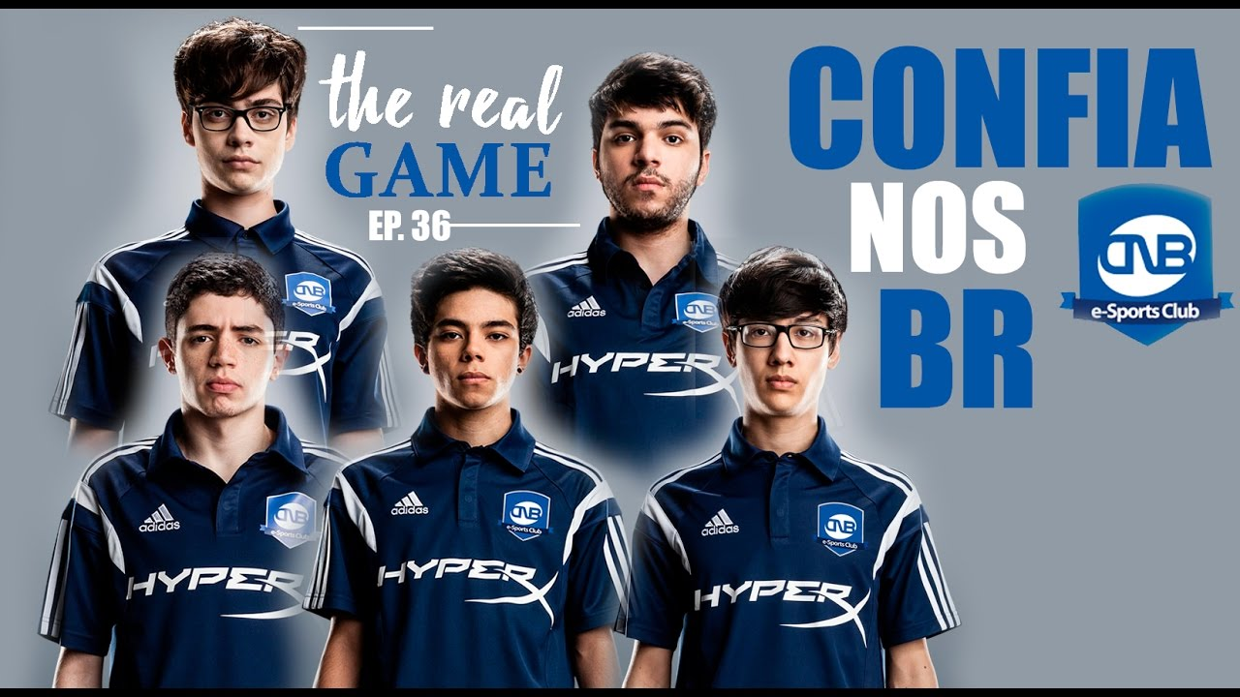
EVOLUCIóN DEL DEPORTE

Slide 5

ENFOQUE
-Rendimiento.
-Resultados.
-Efectividad.

Slide 6


Valor
-Mejora de hábitos visuales.
-Monitorización de estímulos.
-Recolección de datos.

Slide 7
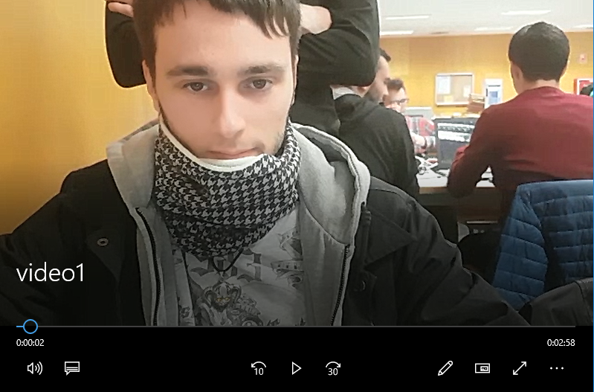
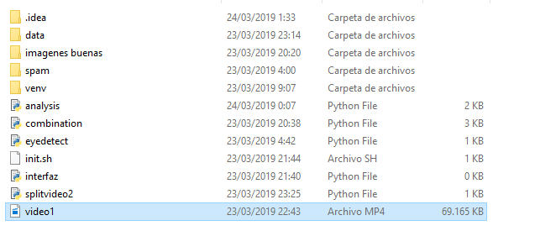
Demo

Slide 8
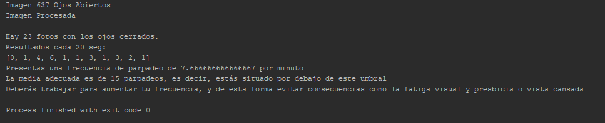

Slide 9
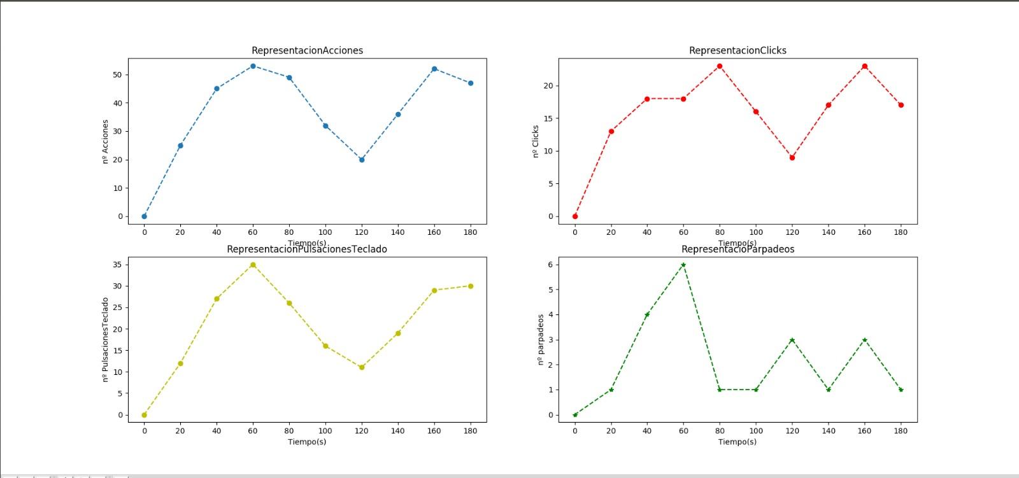

Slide 10
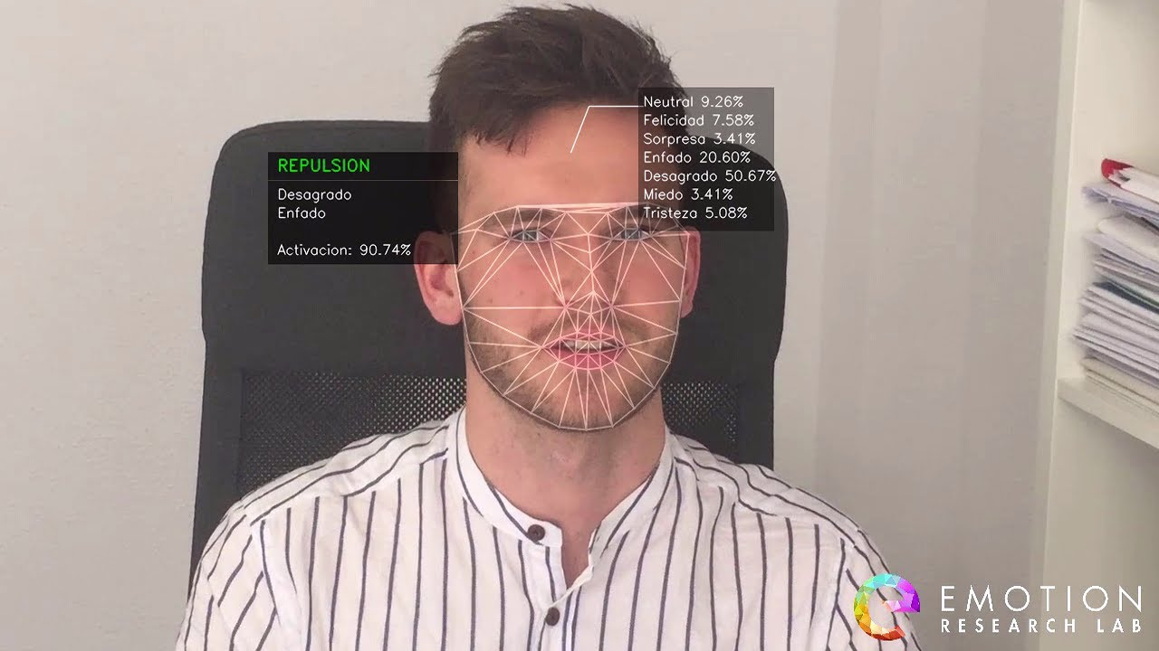

VECTORES DE MEJORA
-Reconocimiento de emociones.
-Mejora de la compresión de los datos.

Slide 11

Q
A
&

Slide 12

¡GRACIAS!

Slide 13

remember
Get something working (PoC)
Use all your technical skills
Try to create a real business impact
To prepare a nice presentation (recorded demo)

Slide 14

ShoW
A STORY THAT OTHERS CAN REMEMBER
FIND REAL TANGIBLE VALUE
KEEP IT FOCUSED
MAKE THE EXPERIENCE LIVE

Slide 15
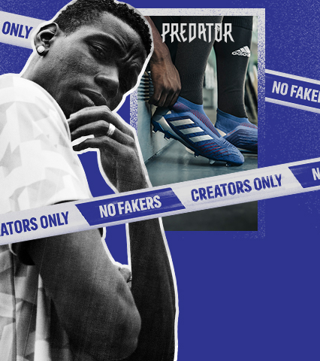
Judging criteria
TECHNICAL IMPLEMENTATION AND COLLABORATION FOR THE USE OF HETEROGENEOUS TECHNOLOGIES: 25%
CONFIDENCE TO ADD VALUE AND CREATE A REAL-LIFE BUSINESS IMPACT: 25%
EFFECTIVE COMMUNICATION AND SUMMARY OF RESULTS: 25%
INNOVATION AND CREATIVITY: 25%

Slide 16

rules
Only genuine work done along this hackathon will be evaluated
OPEN SOURCE by default
The more relevant to the challenge topic the better
All technical skills are welcome
Presentations: 6 + 2 + 2
(6 mins pitch + 2 mins questions +
2 mins switching teams)

